Slide 1


Slide 2


Office 365 installation instructions
ICTUOC – Center of Infrastructure Technology Services, Informatics and Communications

Slide 3
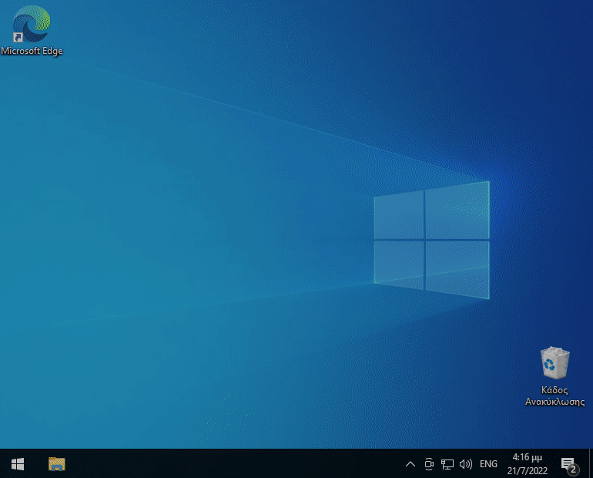
Make sure that you have not installed any other version of Microsoft Office on your computer.
If there is one, you should remove it from «Apps» in your computer «Settings».
Office 365 installation instructions
Preparation
ICTUOC – Center of Infrastructure Technology Services, Informatics and Communications

Slide 4
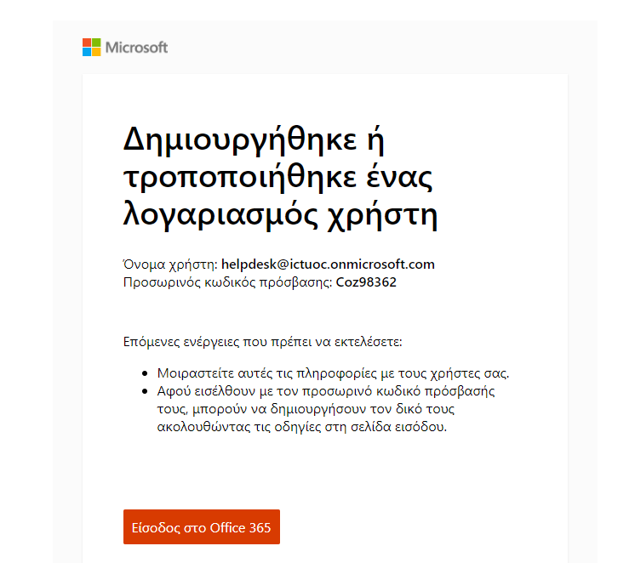
You have received an email with your account activation details from Microsoft .
Office 365 installation instructions
ICTUOC – Center of Infrastructure Technology Services, Informatics and Communications

Slide 5

Make sure that you have received an email from Microsoft (ms-noreply@microsoft.com) on behalf of your organization, with the title «Account information for new or modified users».
Office 365 installation instructions
STEP 1.
ICTUOC – Center of Infrastructure Technology Services, Informatics and Communications

Slide 6
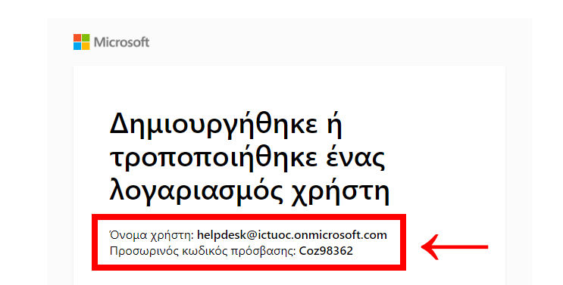
Note the username and the temporary access code that you have been provided with.
Office 365 installation instructions
STEP 2.
ICTUOC – Center of Infrastructure Technology Services, Informatics and Communications

Slide 7
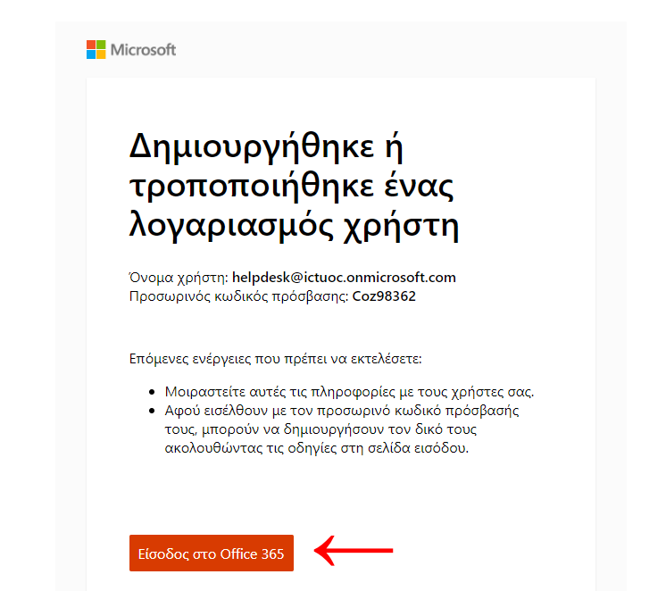
By clicking on «Sign in to Office 365» you will be redirected to the login page.
Office 365 installation instructions
STEP 3.
ICTUOC – Center of Infrastructure Technology Services, Informatics and Communications

Slide 8
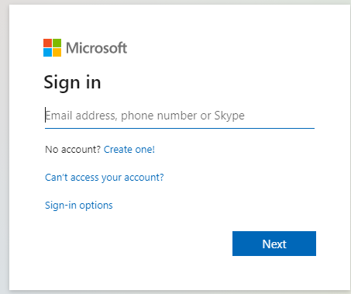
On the login page, fill in the username that has been provided to you (unless it is automatically filled), and the temporary access code you have noted in step 2 and click «Sign in».
Office 365 installation instructions
STEP 4.
ICTUOC – Center of Infrastructure Technology Services, Informatics and Communications

Slide 9
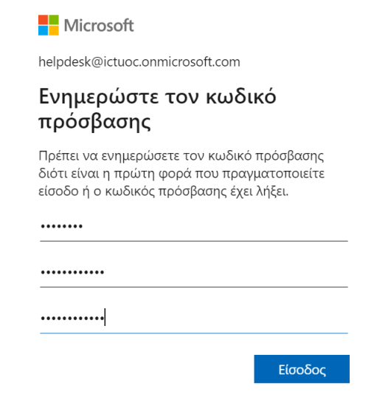
The replacement of the temporary access code is essential.
The new password should be at least 8 characters long and meet 3 of the following requirements:
Contain uppercase letters
Contain lowercase letters
Contain numbers
Contain symbols
Office 365 installation instructions
STEP 5.
ICTUOC – Center of Infrastructure Technology Services, Informatics and Communications

Slide 10
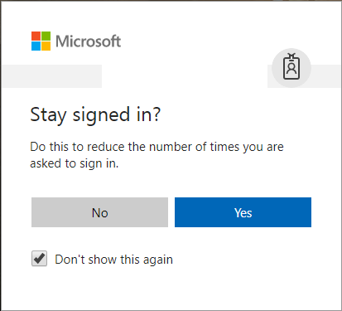
Once you have successfully completed the previous step, choose if you want to stay connected to your new Microsoft account.
Office 365 installation instructions
STEP 6.
ICTUOC – Center of Infrastructure Technology Services, Informatics and Communications

Slide 11
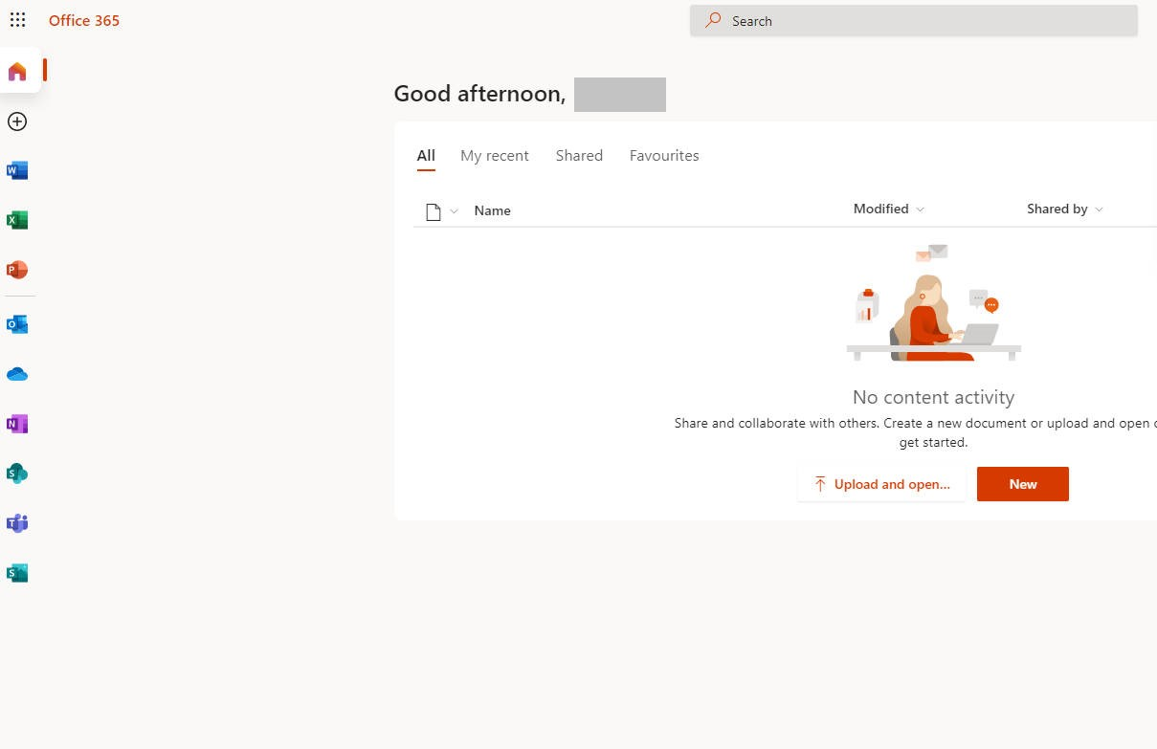
In this step you should be in the Office 365 online website.
From this page you can download the Office 365 file on your computer.
Office 365 installation instructions
STEP 7.
ICTUOC – Center of Infrastructure Technology Services, Informatics and Communications

Slide 12
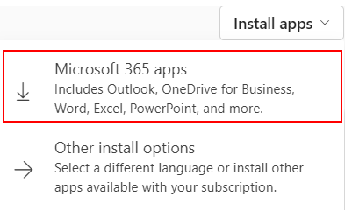
In the top right corner of the page, there is a list of options with title «Office installation».
By clicking on the list and selecting «Office 365 Apps», the download of the installation file begins.
Office 365 installation instructions
STEP 8.
ICTUOC – Center of Infrastructure Technology Services, Informatics and Communications

Slide 13
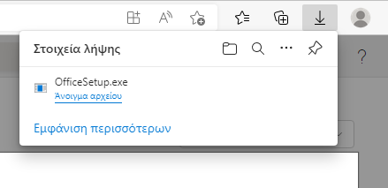
Once the download is completed, select «Open file».
Office 365 installation instructions
STEP 9.
ICTUOC – Center of Infrastructure Technology Services, Informatics and Communications

Slide 14
Depending on your computer security settings, you may see the following message. Select «Yes» and the installation begins.
Office 365 installation instructions
STEP 10.
ICTUOC – Center of Infrastructure Technology Services, Informatics and Communications

Slide 15
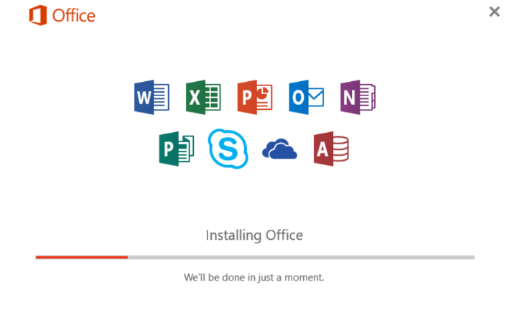
The installation might take a while.
If the installation takes place on a laptop, make sure that the laptop is plugged in.
Office 365 installation instructions
STEP 11.
ICTUOC – Center of Infrastructure Technology Services, Informatics and Communications

Slide 16
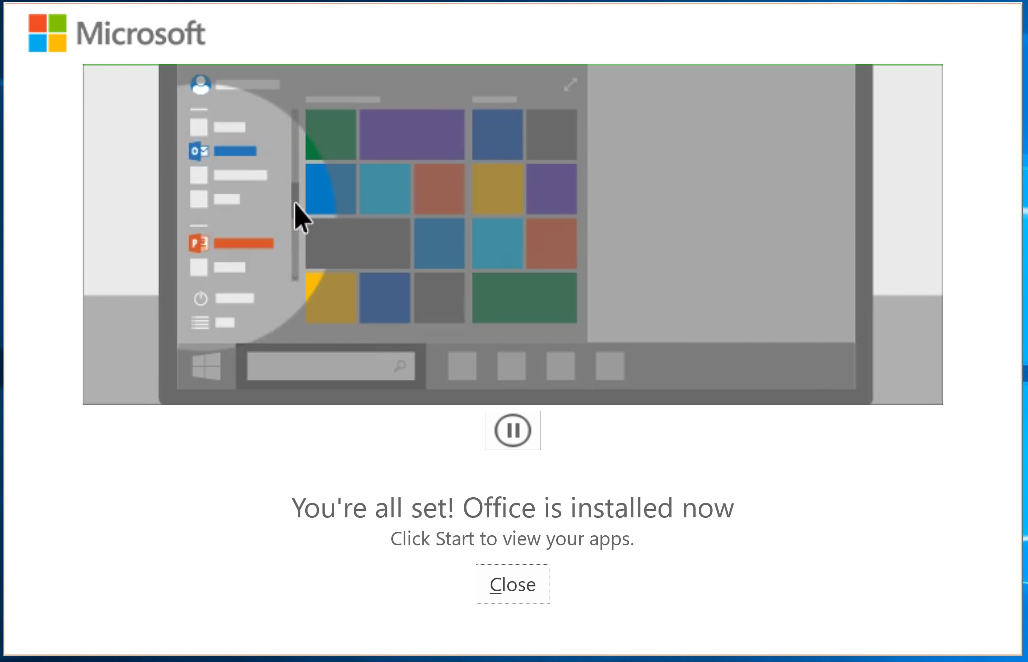
The installation of Microsoft Office 365 is finished. Close the installation wizard and now you can search the Menu and open one of the Microsoft Office applications.
Office 365 installation instructions
STEP 12.
ICTUOC – Center of Infrastructure Technology Services, Informatics and Communications

Slide 17
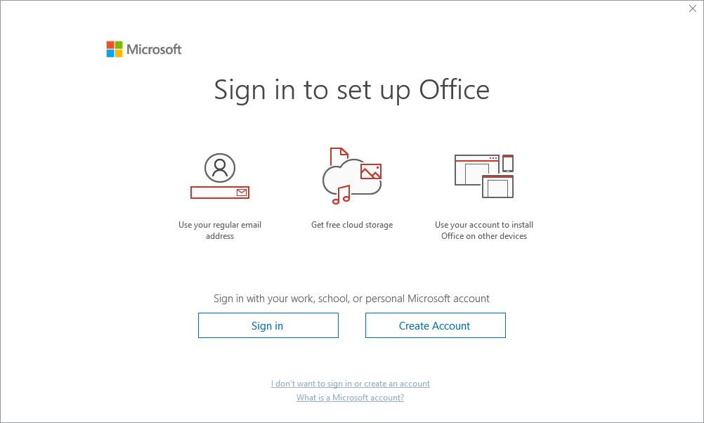
On the first use of one of the Microsoft Office 365 Applications (e.g. Excel) it is necessary to select «Sign in» and sign in with your new Microsoft account in order to activate the product.
Office 365 installation instructions
STEP 13.
ICTUOC – Center of Infrastructure Technology Services, Informatics and Communications

Slide 18
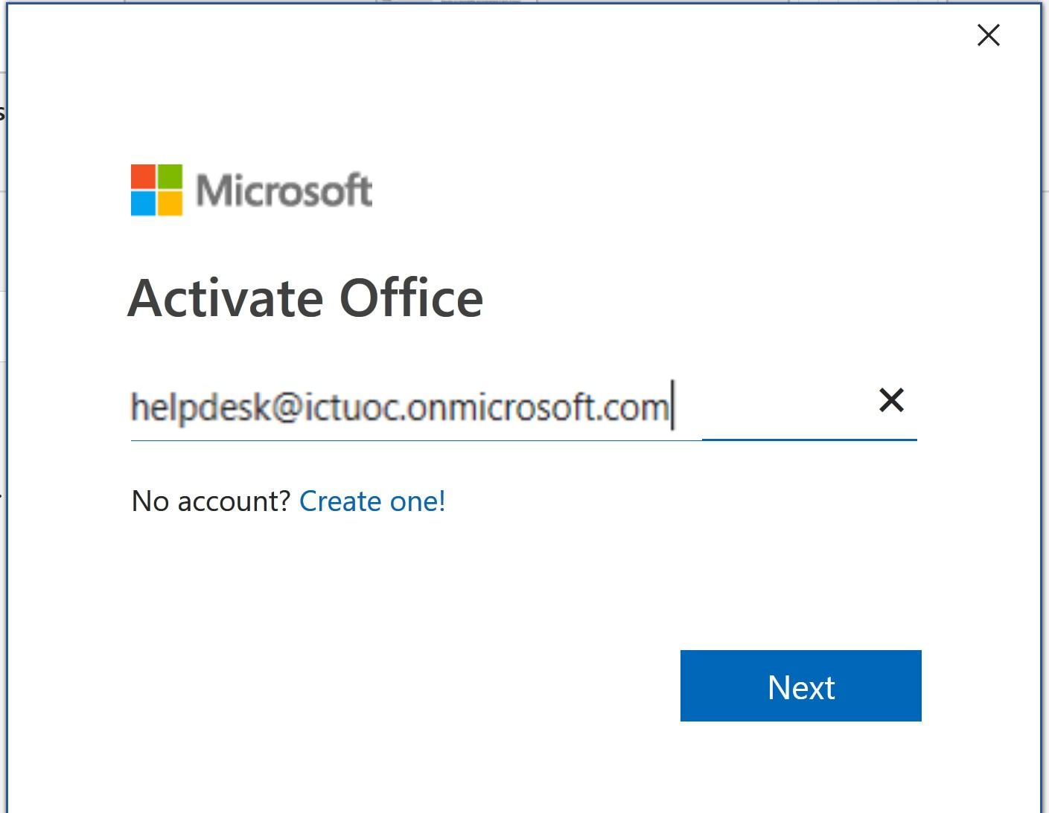
Fill in the username that you have been provided with in Step 2 and click «Next».
Office 365 installation instructions
STEP 14.
ICTUOC – Center of Infrastructure Technology Services, Informatics and Communications

Slide 19
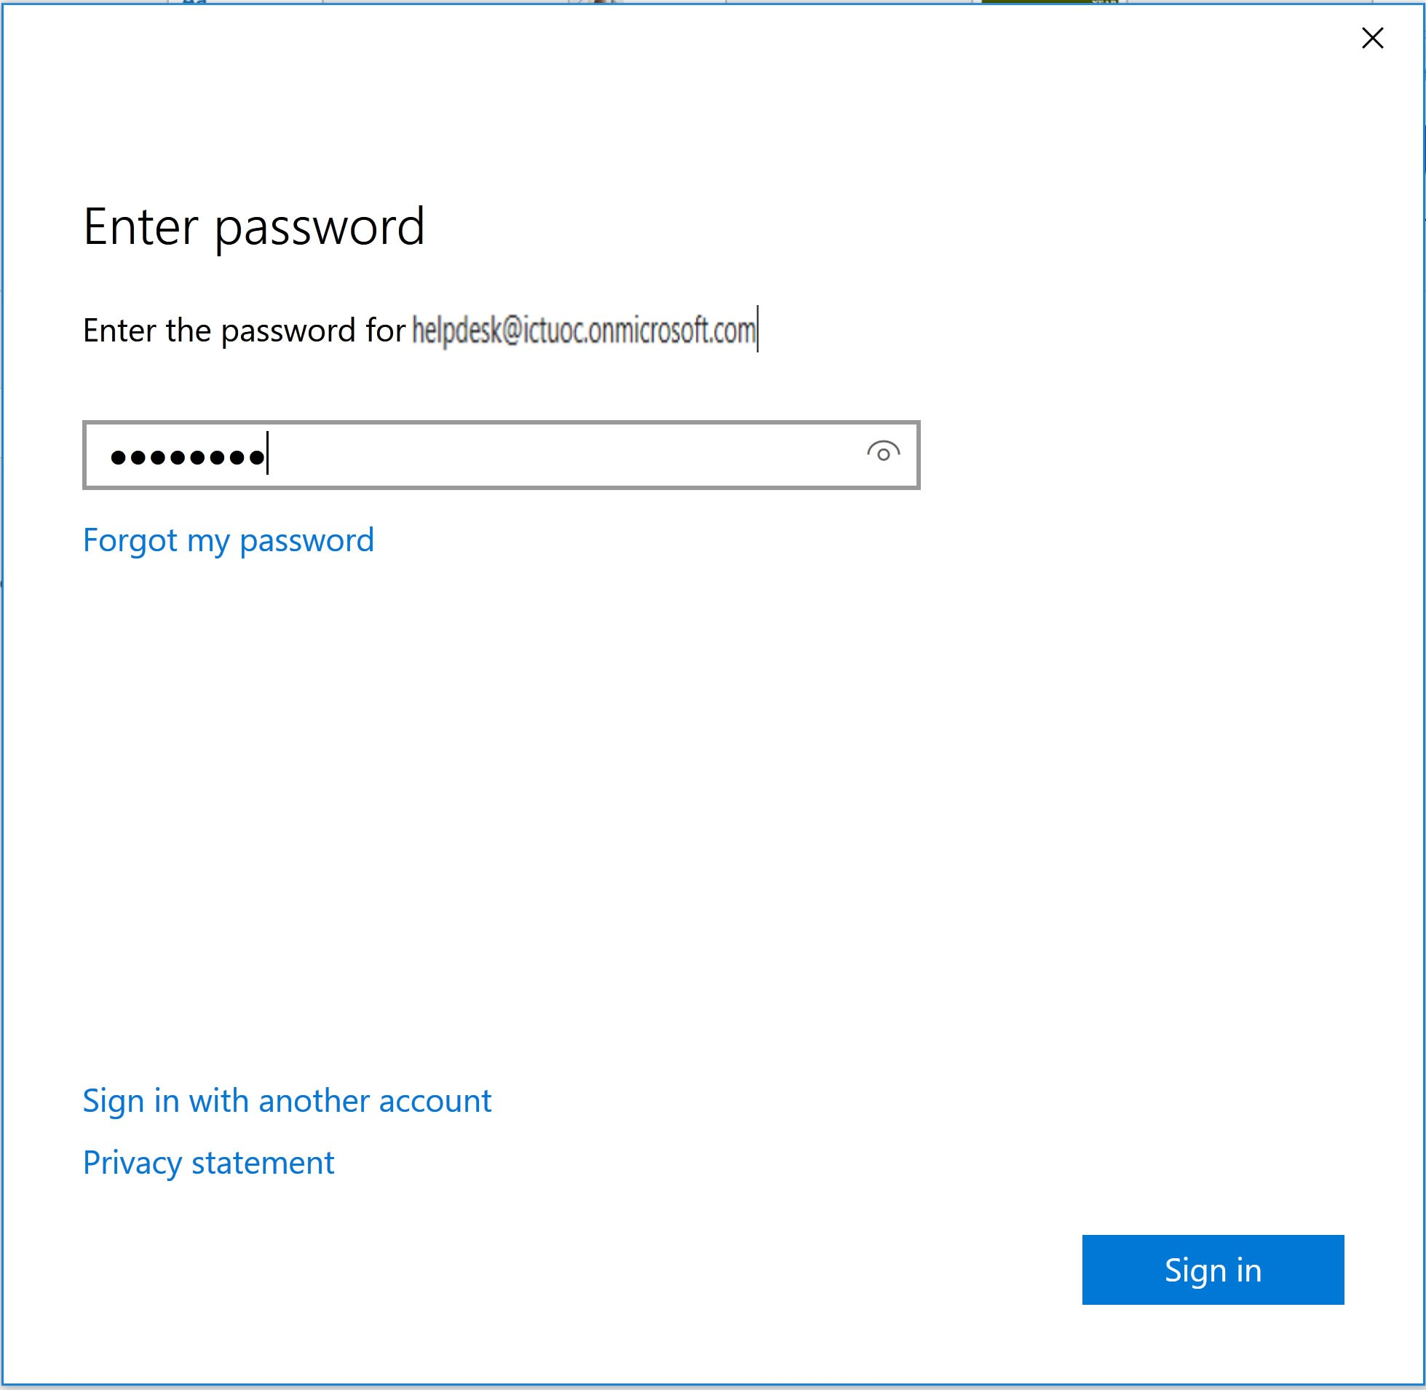
Fill in the password you created in step 5 and select «Sign in».
Office 365 installation instructions
STEP 15.
ICTUOC – Center of Infrastructure Technology Services, Informatics and Communications

Slide 20
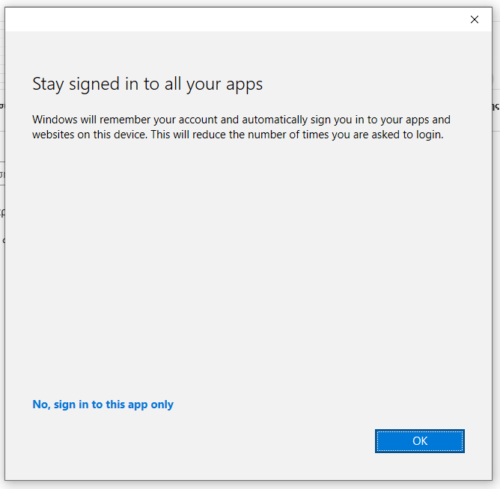
Once the account details have been entered correctly, the guide will ask you if you want to save these details for future use.
For your convenience, it is recommended that you select OK.
Office 365 installation instructions
STEP 16.
ICTUOC – Center of Infrastructure Technology Services, Informatics and Communications

Slide 21
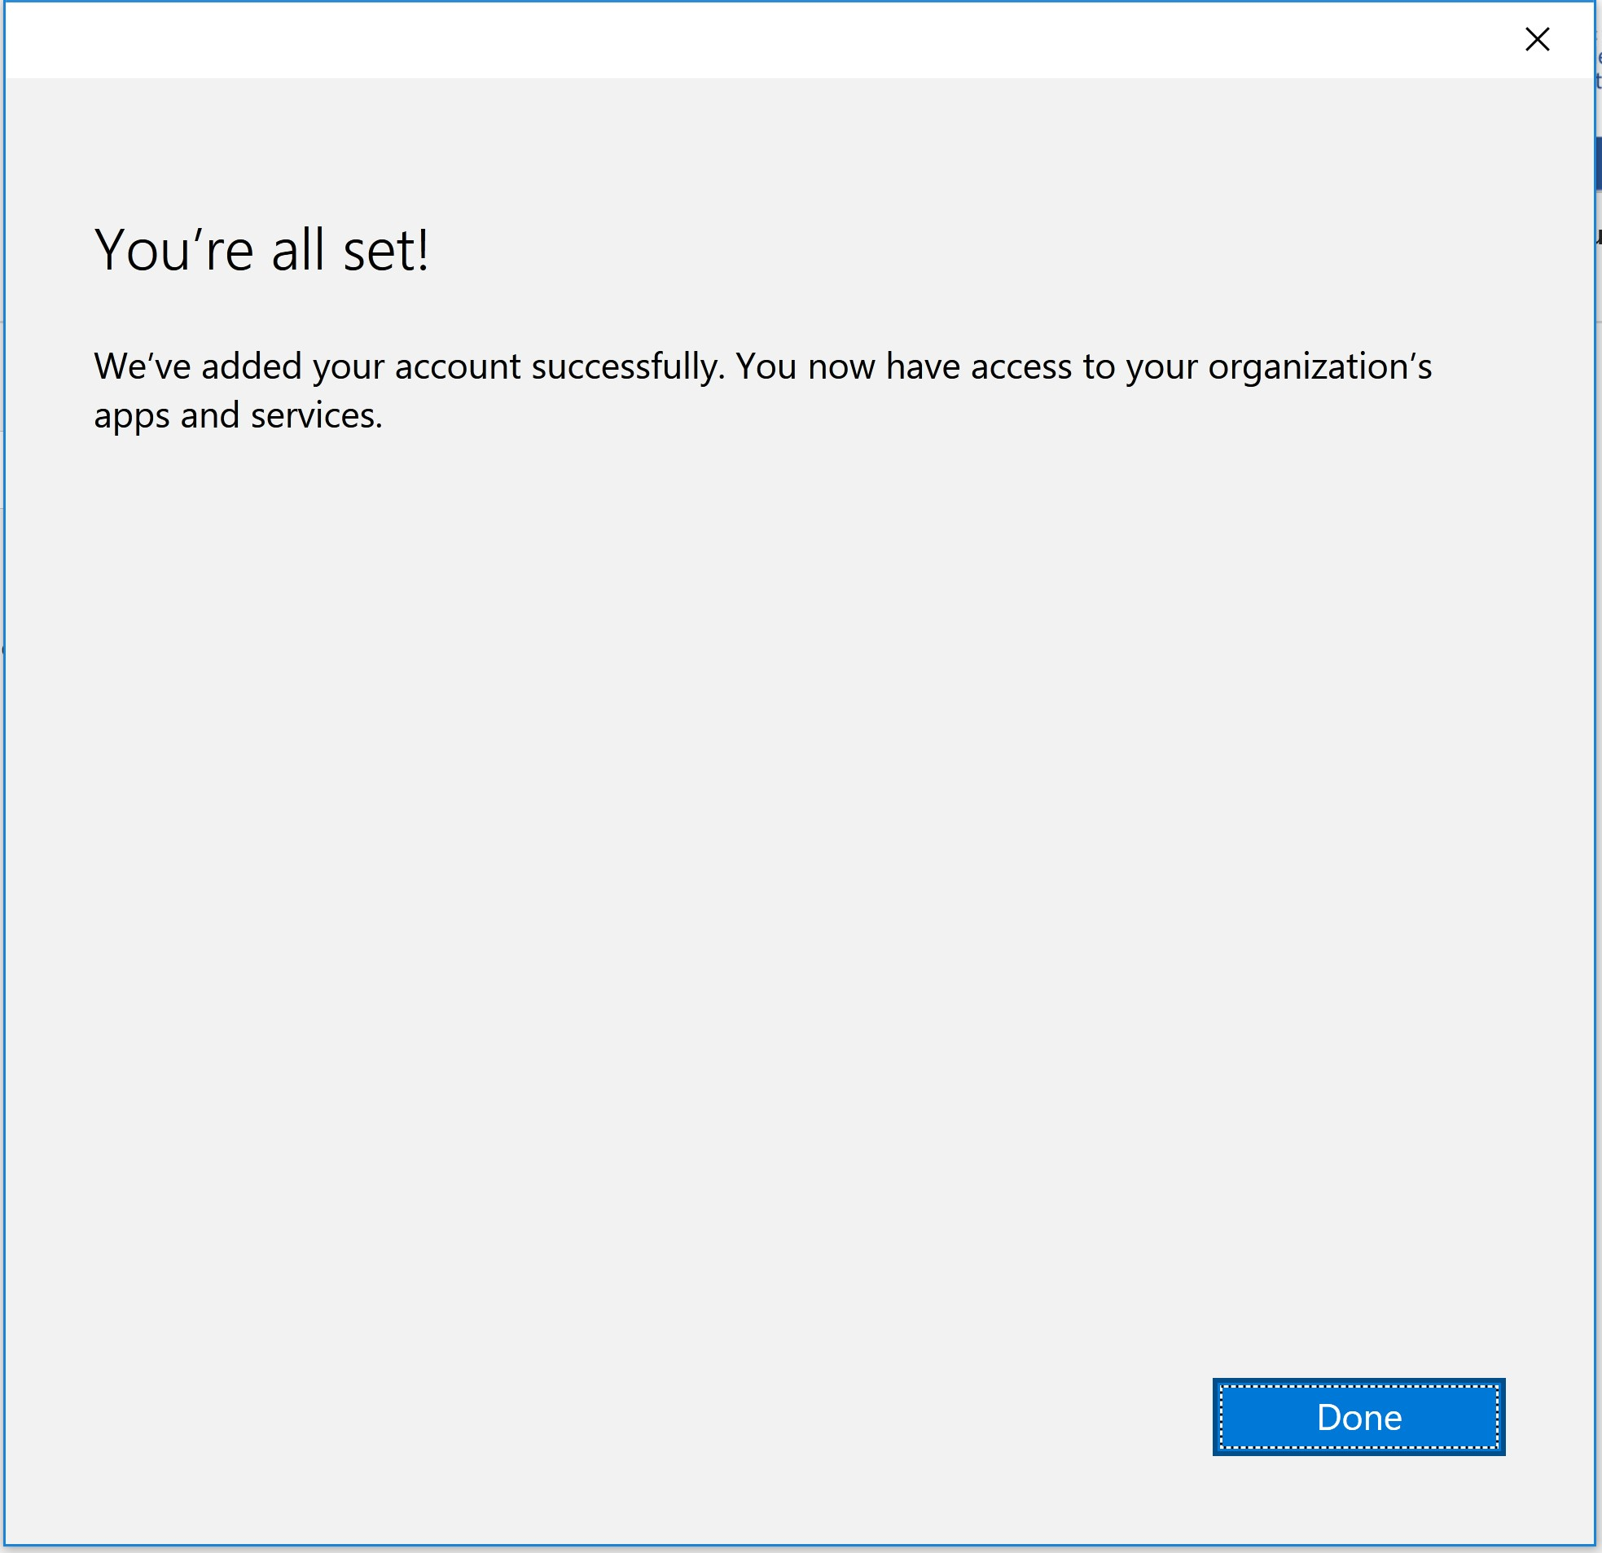
The installation and activation processes have been completed. Press the «Finish» button.
Now you can use Microsoft Office by choosing the desired application (Word, Excel, etc.) from the Menu.
Office 365 installation instructions
STEP 17.
ICTUOC – Center of Infrastructure Technology Services, Informatics and Communications

Slide 22
In order to access Microsoft Office 365, contact the secretary of your department and the Helpdesk for further information.
(email: helpdesk@uoc.gr, tel: 281 039 3312)

